Slide 1
Binary Search Tree
Asim Rehan

Slide 2
Binary Search Tree
In a binary tree, every node can have a maximum of two children but there is no need to maintain the order of nodes basing on their values.
“Binary Search Tree is a binary tree in which every node contains only smaller values in its left subtree and only larger values in its right subtree”
Notes:
A binary search tree (BST), also known as an ordered binary tree, is a node-based data structure in which each node has zero, one or two child nodes. ... The left sub-tree contains only nodes with keys less than the parent node; the right sub-tree contains only nodes with keys greater than the parent node

Slide 3
Applications
Used in many search applications where values are keep on changing.
Maps
Video Games
Syntax tree
Notes:
As the Tree organizes the data to it is used in Searching Applications.
Constantly values are getting entered and getting removed.
Constructed by compliers.

Slide 4
Operations on a Binary Search Tree
The following operations are performed on a binary search tree.
Search
Insertion
Deletion

Slide 5
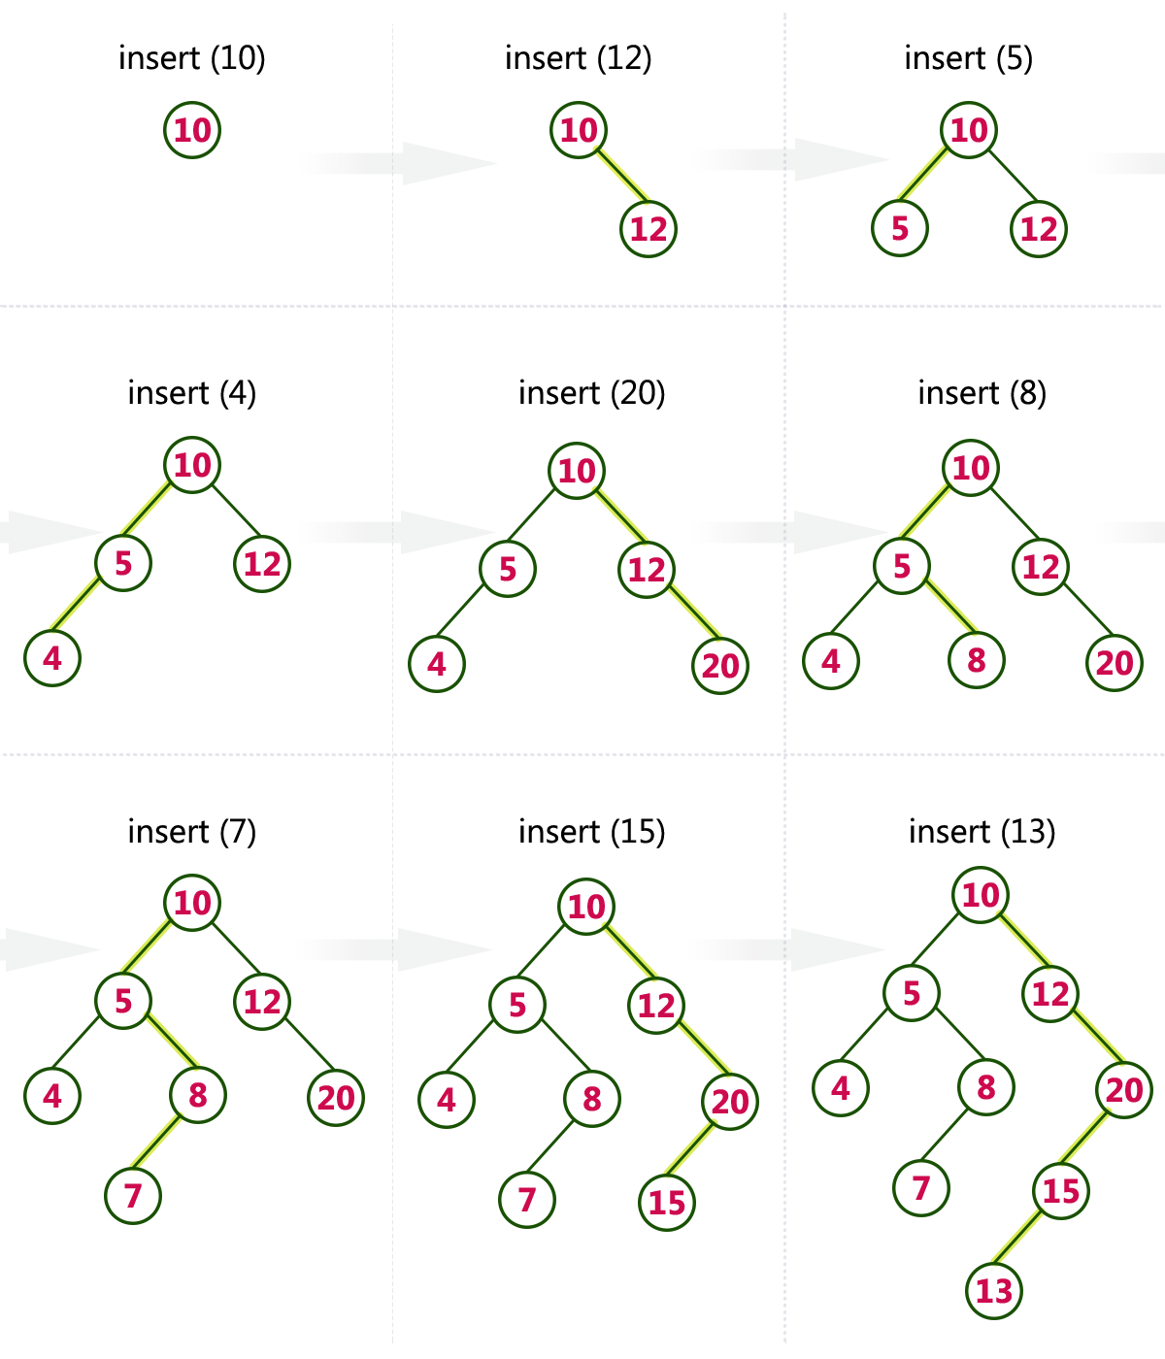
Insertion / Construction
10,12,5,4,20,8,7,15,13
Notes:
Construct a Binary Search Tree by inserting the following sequence of numbers.

Slide 6
Deletion
To delete a node x from a BST, three cases can be considered:
x is a leaf.
x has one child
x has two children
x is a leaf:
If x is the left child of its parent then make the left pointer of x’s parent a null pointer.
If x is the right child of its parent, then make the right pointer of x’s parent a null pointer.

Slide 7
Deletion
To delete the node containing I:
Make the left pointer of M a null pointer.
Return x to the heap
C
O
H
P
E
M
U
I
x
T

Slide 8
Deletion
x has one child:
Set the appropriate pointer in x’s parent point to the child of x.
Return x to the heap
C
O
H
P
E
M
x
U
I
T

Slide 9
Deletion
To delete a node x having two children:
This can be reduced to other two cases
the value in the node x is replaced by:
Its inorder successor
Or inorder predecessor
And then delete the successor or the predecessor accordingly.

Slide 10
Deletion
x has two children:
For example to delete J
Replace with Minimum value from right sub tree of J.
G
x
F
J
A
H
O
E
I
M
P
C
K
N
B
D
L
Notes:
Replace with Minimum value from right sub tree.

Slide 11
Deletion
Replace J with K.
Adjust the pointer of K’s parent M.
G
K
x
F
J
A
H
O
E
I
M
P
C
K
N
B
D
L

